Slide 1
Compounds and mixtures
11 Chemistry

Slide 2
Learning goals
• State that pure substances may be elements or compounds.
• Identify that pure substances have distinct measurable properties (e.g. melting and boiling point, reactivity, strength, density) and mixtures have properties dependent on the identity and relative amounts of the substances that make them up.
• Discriminate between heterogeneous and homogeneous mixtures.
• Analyse data to determine the physical properties of pure substances and mixtures.

Slide 3
Warm Up Match up key words to definitions
Element
Made up of two or more different types of atoms which are chemically bonded.
Compound
Made up of one type of atom.
Made up of two or more different types of atoms or compounds which are not chemically bonded.
Mixture

Slide 4
What does pure mean in chemistry?
A pure substance is a single element or compound that is not mixed with any other substances.

Slide 5
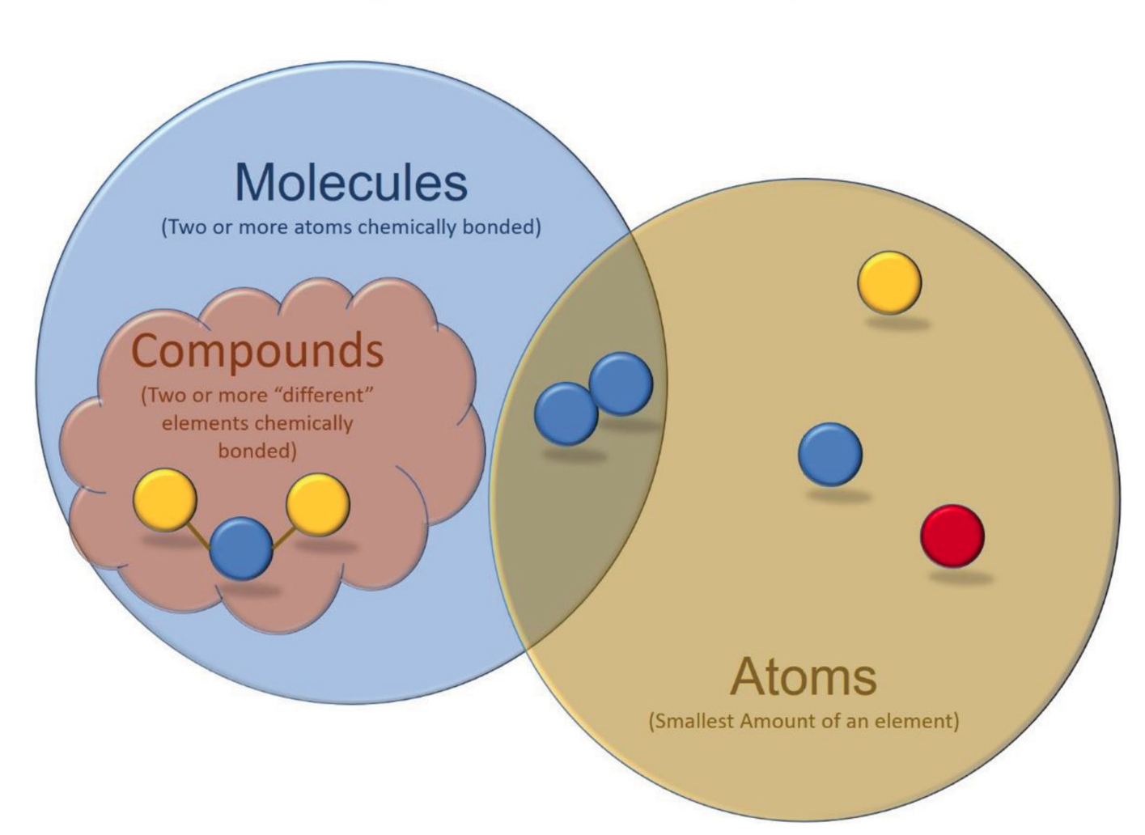
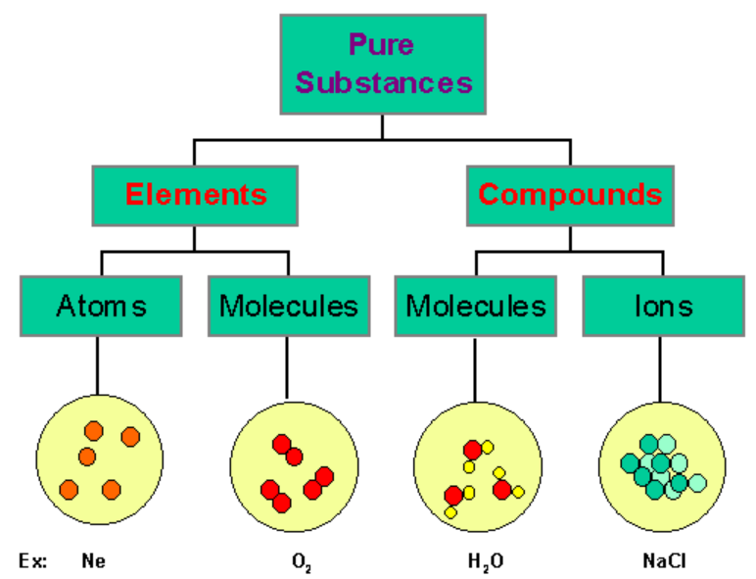

Slide 6
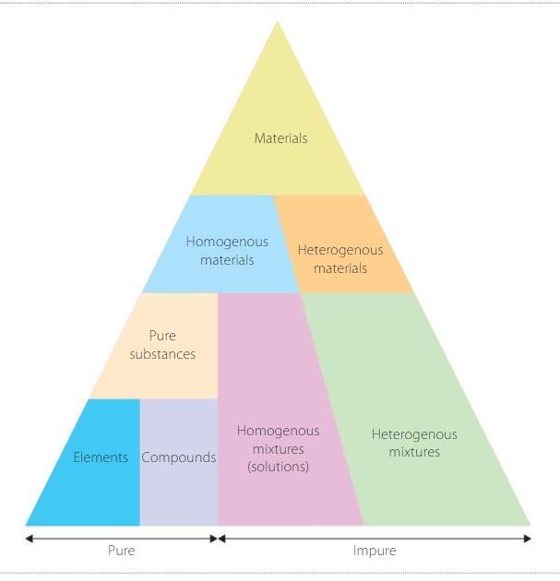
Notes:
Elements - typically metals, used in coins since around 500 BC. Typically gold due to the colour and unreactive properties, though often a homogenous mixture with silver .
diamond/coal/graphene – all allotropes (different forms) of carbon. Formation conditions influence these heavily (e.g. diamond forms @ 3000ºC and 100 000 atm). We call the non-crystalline variety amorphous shapes (amorphous = not clearly defined). Homogenous mixtures – often solutions (e.g. water, copper sulfate), though alloys have been essential for the development of society (steel, weapons & building development, coins etc.) This is significant as we can alter the substance to reflect the desired properties.
Synthetic diamonds are a great example – the nitrogen in the air (an impurity) often produces a yellow colour. Other impurities can be added to influence the colour of the diamond. This makes them a homogenous mixture.
Heterogenous mixture -
Heterogenous mixtures -

Slide 7

How can we test if something is pure?
The test for pure water is if its melting point is at 0°C and if its boiling point is exactly 100°C.
You can use melting points and boiling points to check if something is pure.
Other properties such as density, bond strength and chemical reactivity are also unique for a pure substance.

Slide 8
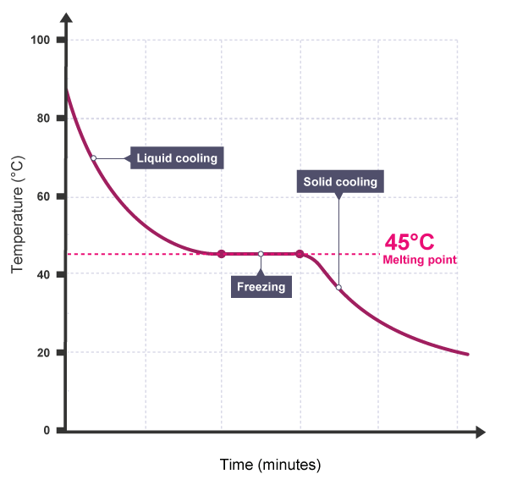
Distinguishing between pure substances and mixtures
Pure substances have a sharp melting point but mixtures melt over a range of temperatures. This difference is most easily seen when the temperature of a liquid is measured as it cools and freezes. The graph shows the cooling curve for a sample of a compound called salol.
The horizontal part of the graph shows that the salol has a sharp melting point, so it is pure. Impure salol (a mixture of salol and other substances) would produce a gradual fall in temperature as it freezes.
See next slide for graph.
Source: https://www.bbc.com/bitesize/guides/zqqtrwx/revision/1

Slide 9
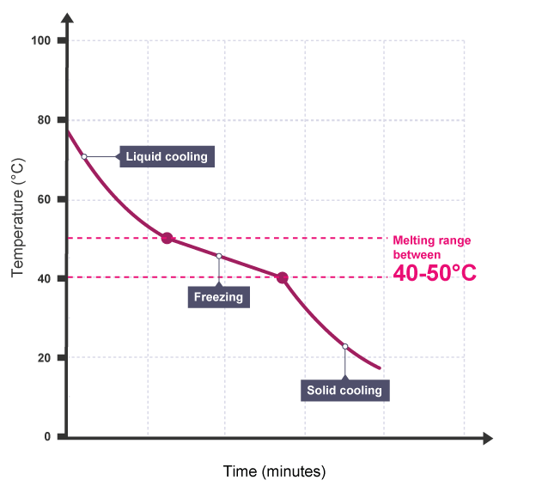
The temperature changes slightly as an impure substance changes state

Slide 10
Mixtures
In knowing the properties of the individual parts of a mixture, we can effectively & efficiently separate it
E.g. distillation
E.g. evaporation

Slide 11
e.g. Water Vs Ethanol
 | Water | Ethanol
Formula | H₂O | C₂H₅OH
Boiling Point | 100 | 78.5
Melting Point | 0 | -114.5
Density (g/L) | 1000 | 789

Slide 12
e.g. milk
An emulsion of fat globules in water
A suspension of casein micelles (protein, with calcium and phosphorus)
Includes dissolved lactose, whey proteins and minerals

Slide 13
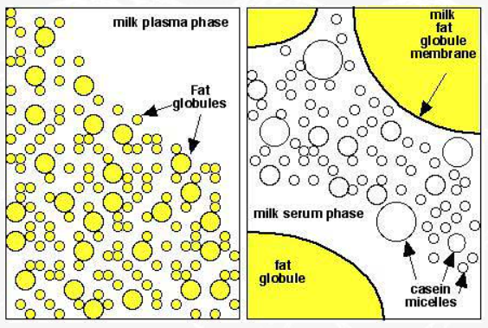
e.g. Milk
 | Full Fat Milk (3.6% fat) | Skim Milk (0.02% fat)
Density (g/L) | 1029 | 1033
Colour | White-yellow | White-blue
Surface Tension (mN/m) | 50-52mN/m | 55-60mN/m
Viscosity (mPa/sec) | 2.0-2.1 | 1.5-1.8
X 500 x 50000

Slide 14
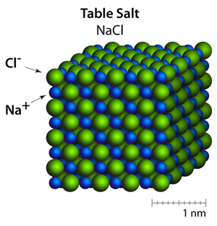
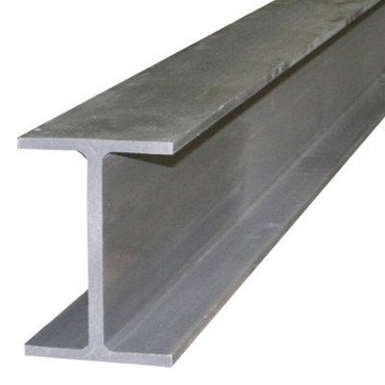
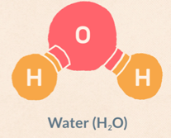
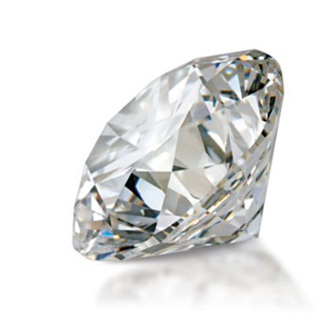
Classifying Compounds
Ionic
Metallic
Covalent
Covalent Network

Slide 15
Questions
Research the following questions:
Why can melting and boiling points be used to test for purity?
Explain how we would know if your substance was a mixture.
How do impurities affect the boiling/melting points?
Explain how the density of a known substance such as aspirin can assist to establish its purity.
An impure sample melts over a range of temperatures from 101℃ to 117℃. Deduce the temperature the sample would likely melt at, if it were pure.
You can refer to the ‘Pure and Impure Substances Fact Sheet.docx’ as well

Slide 16
Melting and Boiling Points Questions - ANSWERS
1. Why can melting and boiling points be used to test for purity?
A pure substance will have a sharp melting or boiling point instead of a range, which allows you to tell whether it is pure or not.
2. Explain how we would know if your substance was a mixture.
If the melting or boiling point of the substance was over a range of temperatures, instead of a single temperature, then we would know that the substance was a mixture.
3. How do impurities affect and boiling/melting points?
Impurities cause the boiling/melting points of substances to lower and change from a single temperature to a range of temperatures.

Slide 17
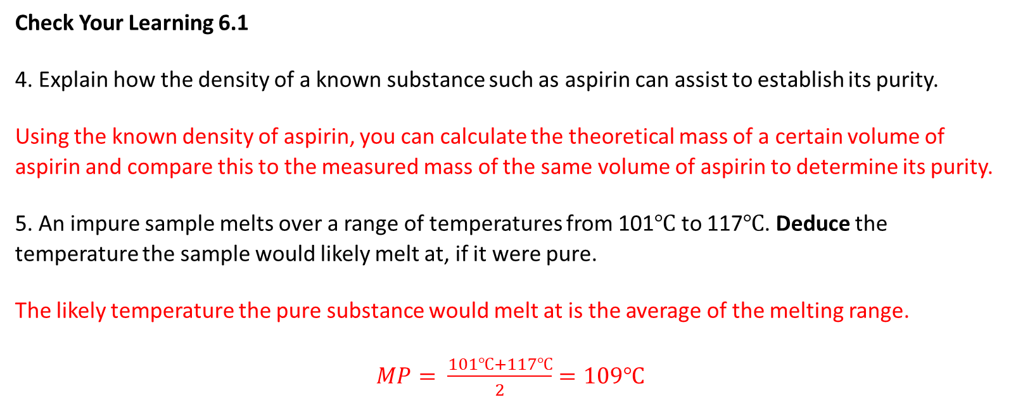
Check Your Learning 6.1 Questions - ANSWERS
Check Your Learning 6.1
4. Explain how the density of a known substance such as aspirin can assist to establish its purity.
Using the known density of aspirin, you can calculate the theoretical mass of a certain volume of aspirin and compare this to the measured mass of the same volume of aspirin to determine its purity.
5. An impure sample melts over a range of temperatures from 101℃ to 117℃. Deduce the temperature the sample would likely melt at, if it were pure.
The likely temperature the pure substance would melt at is the average of the melting range.
$MP= \frac{101℃+117℃}{2}=109℃$

Slide 18
Mixtures (Impure substances)
Define mixture, heterogeneous mixtures, homogeneous mixtures.
Define solution, suspension and colloid and classify each of these as homogeneous or heterogeneous.
Classify each separation technique based on each of the following physical properties: Boiling point, Density, Size
Identify two types of heterogeneous mixtures.
Explain why it is important to know the physical properties of substances when trying to separate a mixture.
Justify why air is considered a homogenous mixture.
Question 3 – Separation Techniques
Centrifugation
Distillation
Filtration
Floatation
Decantation
Crystallisation
Sedimentation

Slide 19
Mixtures Questions - ANSWERS
1. Define mixture, heterogeneous mixtures and homogeneous mixtures.
Mixture – made up of two or more substances that are not chemically bonded
Heterogeneous mixture – a mixture with an inconsistent composition
Homogeneous mixture – a mixture with a uniform composition
2. Define solution, suspension and colloid and classify each of these as homogeneous or heterogeneous.
Solution – a mixture of a solute dissolved in a solvent → Homogeneous
Suspension – a mixture in which a substance is dispersed in another substance → heterogeneous
Colloid – a mixture in which dispersed particles do not separate over time → homogeneous
3. Classify each separation technique based on each of the following physical properties: Boiling point, Density, Size
Boiling point → distillation and crystallisation
Density → sedimentation, flotation, centrifugation and decantation
Size → physical separation and filtration

Slide 20
Mixtures Questions - ANSWERS
4. Identify two types of heterogeneous mixtures.
Possible answers include oil in water, mixed lollies, dirty water, muesli, salads etc.
5. Explain why it is important to know the physical properties of substances when trying to separate a mixture.
The physical properties of the substances you are trying to separate will dictate what types of separating techniques you will use and in what order you will do them.
6. Justify why air is considered a homogenous mixture.
While air is made up of many different substances, they are mixed together to form a uniform consistency and therefore, air is considered homogenous.

